Slide 1
Discussion 01:
Control and Environments
Jennifer Tsui (jtsui@berkeley.edu)
Website: jentsui.github.io
Slides for each week will be posted on my website!

Slide 2
Announcements
HW1 due tonight
Lab 0 + Lab 1 due Friday
Hog out!
Phase 1 due 2/5 (Work individually)
Whole project due 2/7 (Can work in partners for phase 2/3)
You get 1 bonus point for submitting 2/6!
Guerrilla section this Saturday 12-2 pm in Soda 271, 273, 275

Slide 3
Functions/Booleans Practice!
What would Python display (WWPD)?
>>> print(‘hi’ and print(‘one’) and 2)

Slide 4
Functions/Booleans Practice!
What would Python display (WWPD)?
>>> print(‘hi’ and print(‘one’) and 2)
one
None

Slide 5
if/else statements: WWPD?
x = 10
if x >= 5:
print(‘hello’)
print(‘good morning!’)

Slide 6
if/else statements: WWPD?
x = 10
if x >= 5:
print(‘hello’)
print(‘good morning!’)
Output:
hello
good morning!

Slide 7
if/else statements: WWPD?
x = 10
if x >= 5:
print(‘hello’)
if x == 10: print(‘hi’)

Slide 8
if/else statements: WWPD?
x = 10
if x >= 5:
print(‘hello’)
if x == 10: print(‘hi’)
Output:
hello
hi

Slide 9
if/else statements: WWPD?
x = 10
if x != 5:
print(‘hello’)
elif x == 10: print(‘hi’)

Slide 10
if/else statements: WWPD?
x = 10
if x > 5:
print(‘hello’)
else: print(‘hi’)
Output:
hello

Slide 11
1.1a (pg. 2): Wears Jacket
Before you start:
Consider the type of the variables temp and raining.
Are they numbers, booleans, functions, etc.?

Slide 12
1.1a (pg. 2): Wears Jacket
if temp < 60:
return True
elif raining:
return True
else:
return False

Slide 13
1.1a (pg. 2): Wears Jacket
if temp < 60:
return True
elif raining:
return True
else:
return False
return temp < 60 or raining

Slide 14
1.1b (pg. 2): Wears Jacket
Let’s say we have a variable called condition:
if condition:
return True
else:
return False
is equivalent to
return condition

Slide 15
1.1b (pg. 2): Wears Jacket
Let’s say we have a variable called condition:
if condition:
return True
else:
return False
is equivalent to
return condition
Why? Consider 2 cases:
condition is true
2. condition is false

Slide 16
While loops (pg. 3)
Goal: repeat the same statements in a program!
while Condition:
Perform the action
Update the variables used in the condition.

Slide 17
While loops (pg. 3)
Goal: Compute sum = 1 + 2 + 3 + … + n
sum = 0
n = 4
while n != 0:
sum += n
n -= 1
Template:
while Condition:
Perform the action
Update the variables used in the condition.

Slide 18
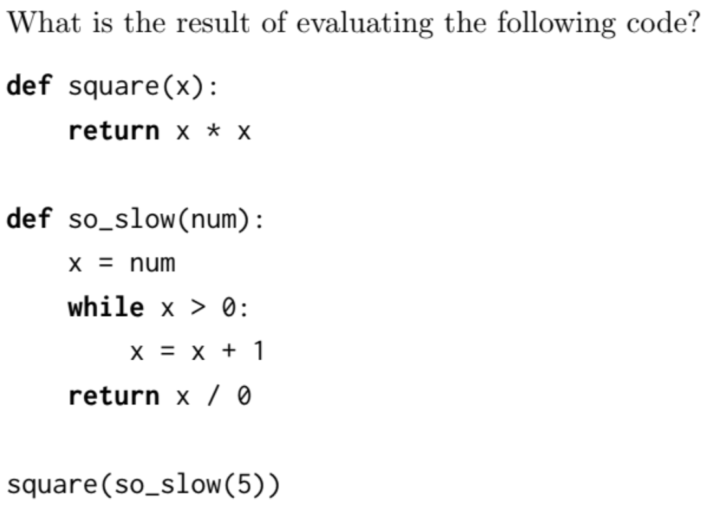
1.2 (pg. 3)

Slide 19
1.2 (pg. 3)
Template:
while Condition:
Perform the action
Update the variables used in the condition.

Slide 20
1.3 (pg. 3): is_prime
Input: n, a number
Output: True if n is prime, False if n is not prime
Prime number: a number that has exactly 2 factors: 1 and itself.
7 is prime because its only factors are 1 and 7;
2, 3, 4, 5, and 6 are not factors
(1 is not a prime number)

Slide 21
1.3 (pg. 3): is_prime
def is_prime(n):
if n == 1:
return False #1 is not prime
factor = 2
while factor < n:
if n % factor == 0:
return False #n is not prime!
factor += 1
return True #n is prime!

Slide 22
Attendance Break!!!
links.cs61a.org/jen
password: fan

Slide 23
Environment Diagrams

Slide 24
Why?
Help us understand complex pieces of code
Historically, they take up half the points on midterm 1
tutor.cs61a.org draws environment diagrams for you
great for checking work
but you need to know how to draw them yourself on an exam!

Slide 25
Motivation
x = 5
def square():
return x*x
x = square()
What will happen?
Error
x will end up as 25
Something else

Slide 26
Environment diagrams
Purpose: Track names and their bindings
Names of variables go on the left!
The values those names are bound to go on the right!
Everything starts off in the global frame!
Notes:
Finish 3:07

Slide 27
Vocab: what does evaluate mean?
Expressions
“Questions”
add(2, 3)
x
Values
“Answers”
5
‘hello’
evaluation
Notes:
What does it mean to evaluate x, where x is the name of a variable? Means to look up the value it’s bound to. But if we’re trying to create the name binding with our assignment statement, we can’t look up x yet since it doesn’t exist within our current environment

Slide 28
Please get out a piece of paper and draw along!
You’ll get better at environment diagrams through practice, not by watching me draw them!

Slide 29
Assignment Statements
Purpose: to define variable names
Going from left to right:
Evaluate the expression on the right hand side of the = sign
Write the variable name and the expression’s value in the current frame
x = 2 + 3
x, y = 100, x
Is y 100 or 5?
Notes:
How to add names and bindings

Slide 30
Assignment Statements
Common Misconceptions:
Names are bound to VALUES, not expressions.
We must evaluate RHS
We DO NOT evaluate the LHS!
Notes:
What does it mean to evaluate x, where x is the name of a variable? Means to look up the value it’s bound to. But if we’re trying to create the name binding with our assignment statement, we can’t look up x yet since it doesn’t exist within our current environment

Slide 31
Defining Functions

Slide 32
def Statements
Purpose: to create function objects and bind them to a name
bound_name ---> func intrinsic_name(parameters) [parent = _ ]
The parent of the function is the frame where it was defined, NOT where it was called!
DO NOT go into the body of function until that function is called!
x = 5
def square():
return x*x
f = square

Slide 33
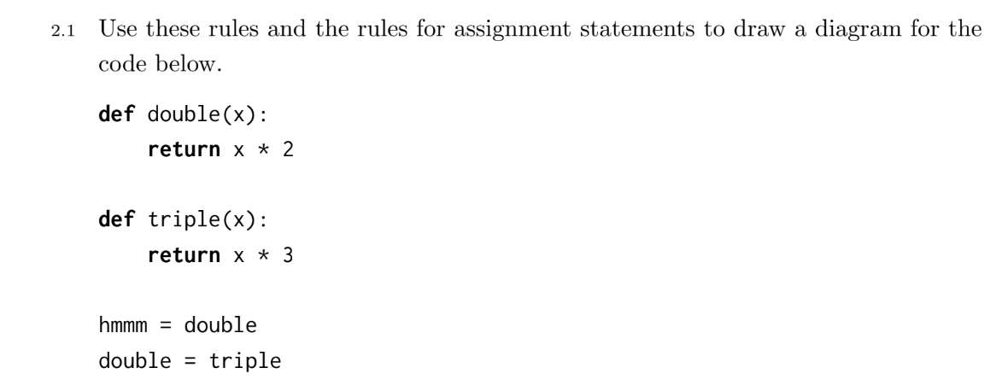
2.2, pg. 5

Slide 34
Calling functions

Slide 35
Function vs. Call Expressions
>>> def f():
return ‘hi’
>>> f

Slide 36
Function vs. Call Expressions
>>> def f():
return ‘hi’
>>> f
>>> f()

Slide 37
Function vs. Call Expressions
>>> def f():
return ‘hi’
>>> f
Function
>>> f()
‘hi’

Slide 38
Square, revisited
x = 5
def square():
return x*x
x = square()
Let’s draw the environment diagram!
Notes:
Draw env diagram on board and don't erase it!
Pause when we get to return x*x
We need to evaluate x (that is, look up the value x is bound to)

Slide 39
Call Expressions
Purpose: apply functions to arguments
Evaluate the operator
Evaluate the operands from left to right
Apply function to arguments
Open a new frame (frame #, intrinsic name, parent frame)
Bind formal parameters to argument values
NOW go into the body of the function and execute until you reach a return value.
Write the return value in the frame
x = 5
def square():
return x*x
x = square()

Slide 40
Variable Lookup Procedure
In the current frame, see if the name exists.
If it doesn’t, look in the parent frame.
Keep doing this until we reach the global frame. If the name doesn’t exist in global, this Errors
x = 5
def square():
return x*x
x = square()

Slide 41
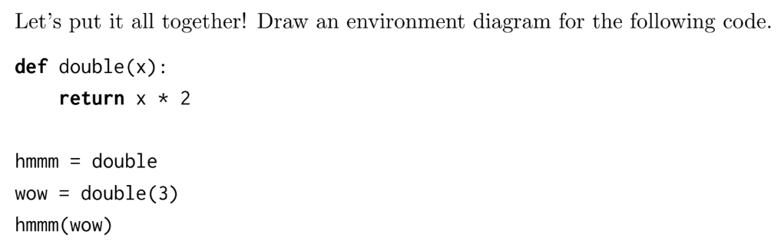
2.3 pg. 6

Slide 42
Call Expressions
Small details:
If a function doesn’t have an explicit return statement, it returns None
For built in functions like add, mul, sub, etc. we don’t open a new frame since we don’t know how these functions are implemented
Every frame except for global must have a return value - this is a good sanity check!

Slide 43
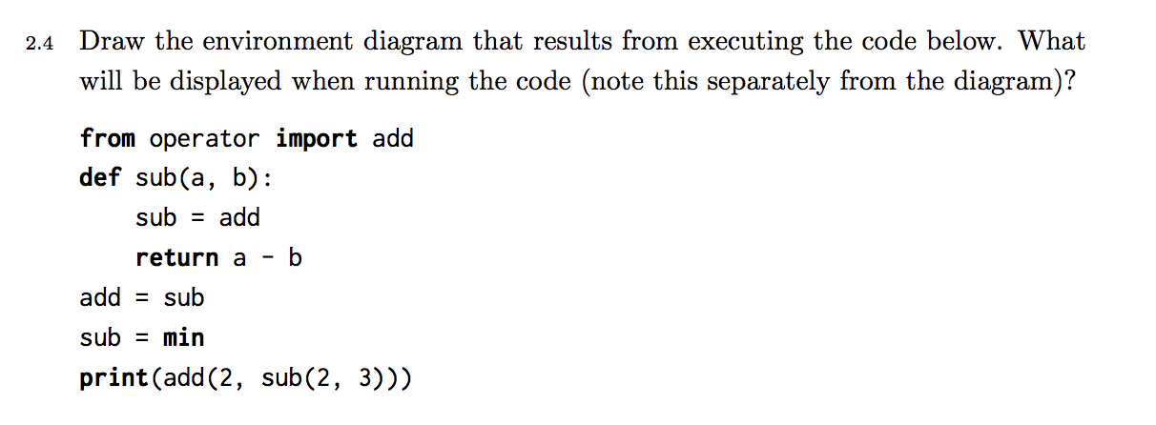
2.4 pg. 7 if we have time

Slide 44
Resources
The material is difficult and it’s perfectly normal to be confused about a topic. If there’s something you don’t quite understand, ask questions and clear up misconceptions early on!
Ask questions on Piazza to share them with the entire class!
Guerrilla section Sat.
cs61a.org/resources

